Slide 1
一起学
Notes:
Black slide left for drafting conclusion

Slide 2
What do you expect/want to learn?
Notes:
Black slide left for drafting conclusion

Slide 3
A few misunderstandings about Data Science
Data science = Coding
Data science = Math
Data science = Fitting a machine learning model
Data science = Deep learning
Notes:
Black slide left for drafting conclusion

Slide 4

Notes:
Black slide left for drafting conclusion

Slide 5
My understanding of key areas to learn in Data Science
Learn programming skills
Learn modeling skills
Learn problem solving skills
Learn skills working in a data science team
Learn presentation skills
Learn data analysis planning skills
Notes:
Black slide left for drafting conclusion

Slide 6
Programming: learn SQL + R/Python
/
Language to query from databases
SQL like thinking is critical in programming
Very good statistics packages
Very good visualization packages
Dplyr!!
Accepted by CS
Closest language to C++/Java
Decent amount of packages
Notes:
Black slide left for drafting conclusion

Slide 7
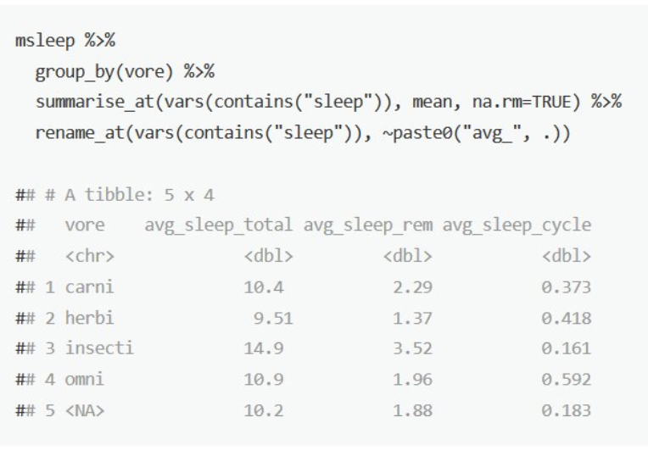
Key areas planed to cover in R
Basic syntax
How to write all codes with data frame (dplyr)
Best tool for visualization (ggplot2)
How to avoid for loop
How to validate
Notes:
Black slide left for drafting conclusion

Slide 8

Goal of a good programmer:
指哪打哪
It is fine to Google
You need to write short code
Code as you think
Notes:
Black slide left for drafting conclusion

Slide 9
Learn enough analytical/modeling skills
Notes:
Black slide left for drafting conclusion

Slide 10
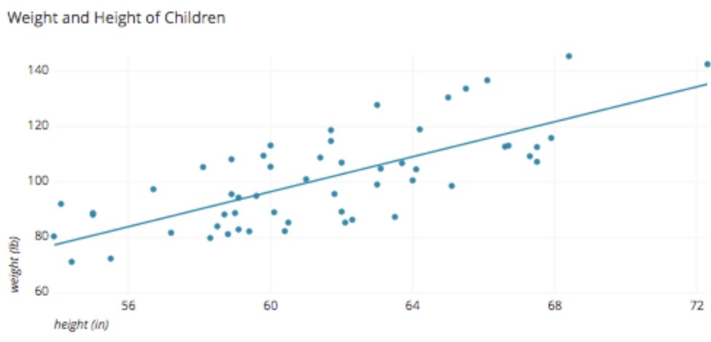
Will cover several key modeling techniques
Operations Research
Basics
Machine learning (regression, tree based, neural network)
Variance decomposition
Notes:
Black slide left for drafting conclusion

Slide 11
Designing two projects to help you learn key data science skills
First project (easy)
Learn
Simple modeling
Second project: median/hard
Learning areas
Learn dealing with complicated data
Learn selecting the right model
Learn making analytical plans
Learn assertion evidence presentation
Well-defined problem
Well-defined data set
R coding
Not well defined problem
Learn problem solving
Notes:
Black slide left for drafting conclusion

Slide 12
Science is not finished until it is communicated.
- Mark Walport
Notes:
Black slide left for drafting conclusion

Slide 13
Learning Assertion Evidence is as important as learning all others
Notes:
Black slide left for drafting conclusion

Slide 14
https://www.assertion-evidence.com/tutorial.html
Notes:
Black slide left for drafting conclusion

Slide 15
Improve yourself in a data science team
How to work with your manager?
What are the data science tasks you will be assigned and how to work on them?
How to prioritize your daily work?
When is the time you need to reach out and ask for questions?
How to improve yourself at work technically and personally?
Notes:
Black slide left for drafting conclusion

Slide 16
敬畏耶和华是智慧的开端， 认识至圣者便是聪明。
Notes:
Black slide left for drafting conclusion

Slide 17
Planning for this course
R basics
Machine Learning basics
dplyr
visualization
Regression
Tree
Neural network
First project (easy)
Get familiar with R
Get familiar with basic modeling techniques
Analytical presentations
Assertion Evidence based presentation
Leverage AE to drive your data science
Work in a data science team
Analytical planning
QA/AC
How to prepare for a meeting
How to work with a data science manager
How to improve yourself in the team
Pathway to be a data science lead
Analytical goals and steps
Value driven
Statistics basics, Operations Research basics
Second project (medium or hard)
Kaggle projects
Natural language processing - dictate Mingqi's sermons
Other projects
Notes:
Black slide left for drafting conclusion

Slide 18
Notes:
Black slide left for drafting conclusion

